Slide 1



CENE 476 Proposal Presentation
Concrete Canoe: Agassiz
By: Carl Wilson
Conrad Senior
Kristen Rasmussen
Logan Grijalva
Stephan Henderson
Date: 12/6/19

Slide 2

1.0 Project Understanding
1.1 Project Purpose
  The National Concrete Canoe Competition (NCCC) is an annual competition that is put on by American Society of Civil Engineers (ASCE).
  NCCC publishes a Request for Proposal document that all teams must abide by. They also provide teams with two addendums with more details about the Presentation and Durability & Repairs.
  These documents are released in the fall prior to the competition in spring.
Figure 1: NCCC Request for Proposals [1]

Slide 3
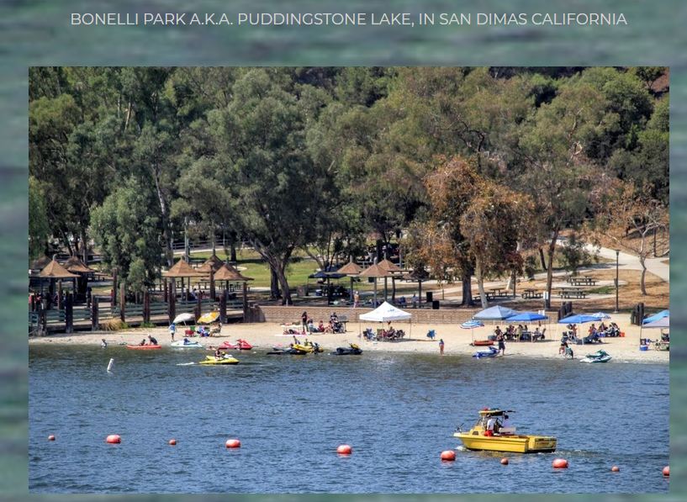
1.0 Project Understanding Cont’d
1.2 Project Background
  This year’s PSWC is hosted by
  California State Fullerton on April 1-4
  Previous Conferences Placement
    2017 NAU placed 8th
    2018 NAU placed 9th
    2019 NAU placed 11th
Figure 2: Puddingstone Lake, San Dimas, California [2]

Slide 4
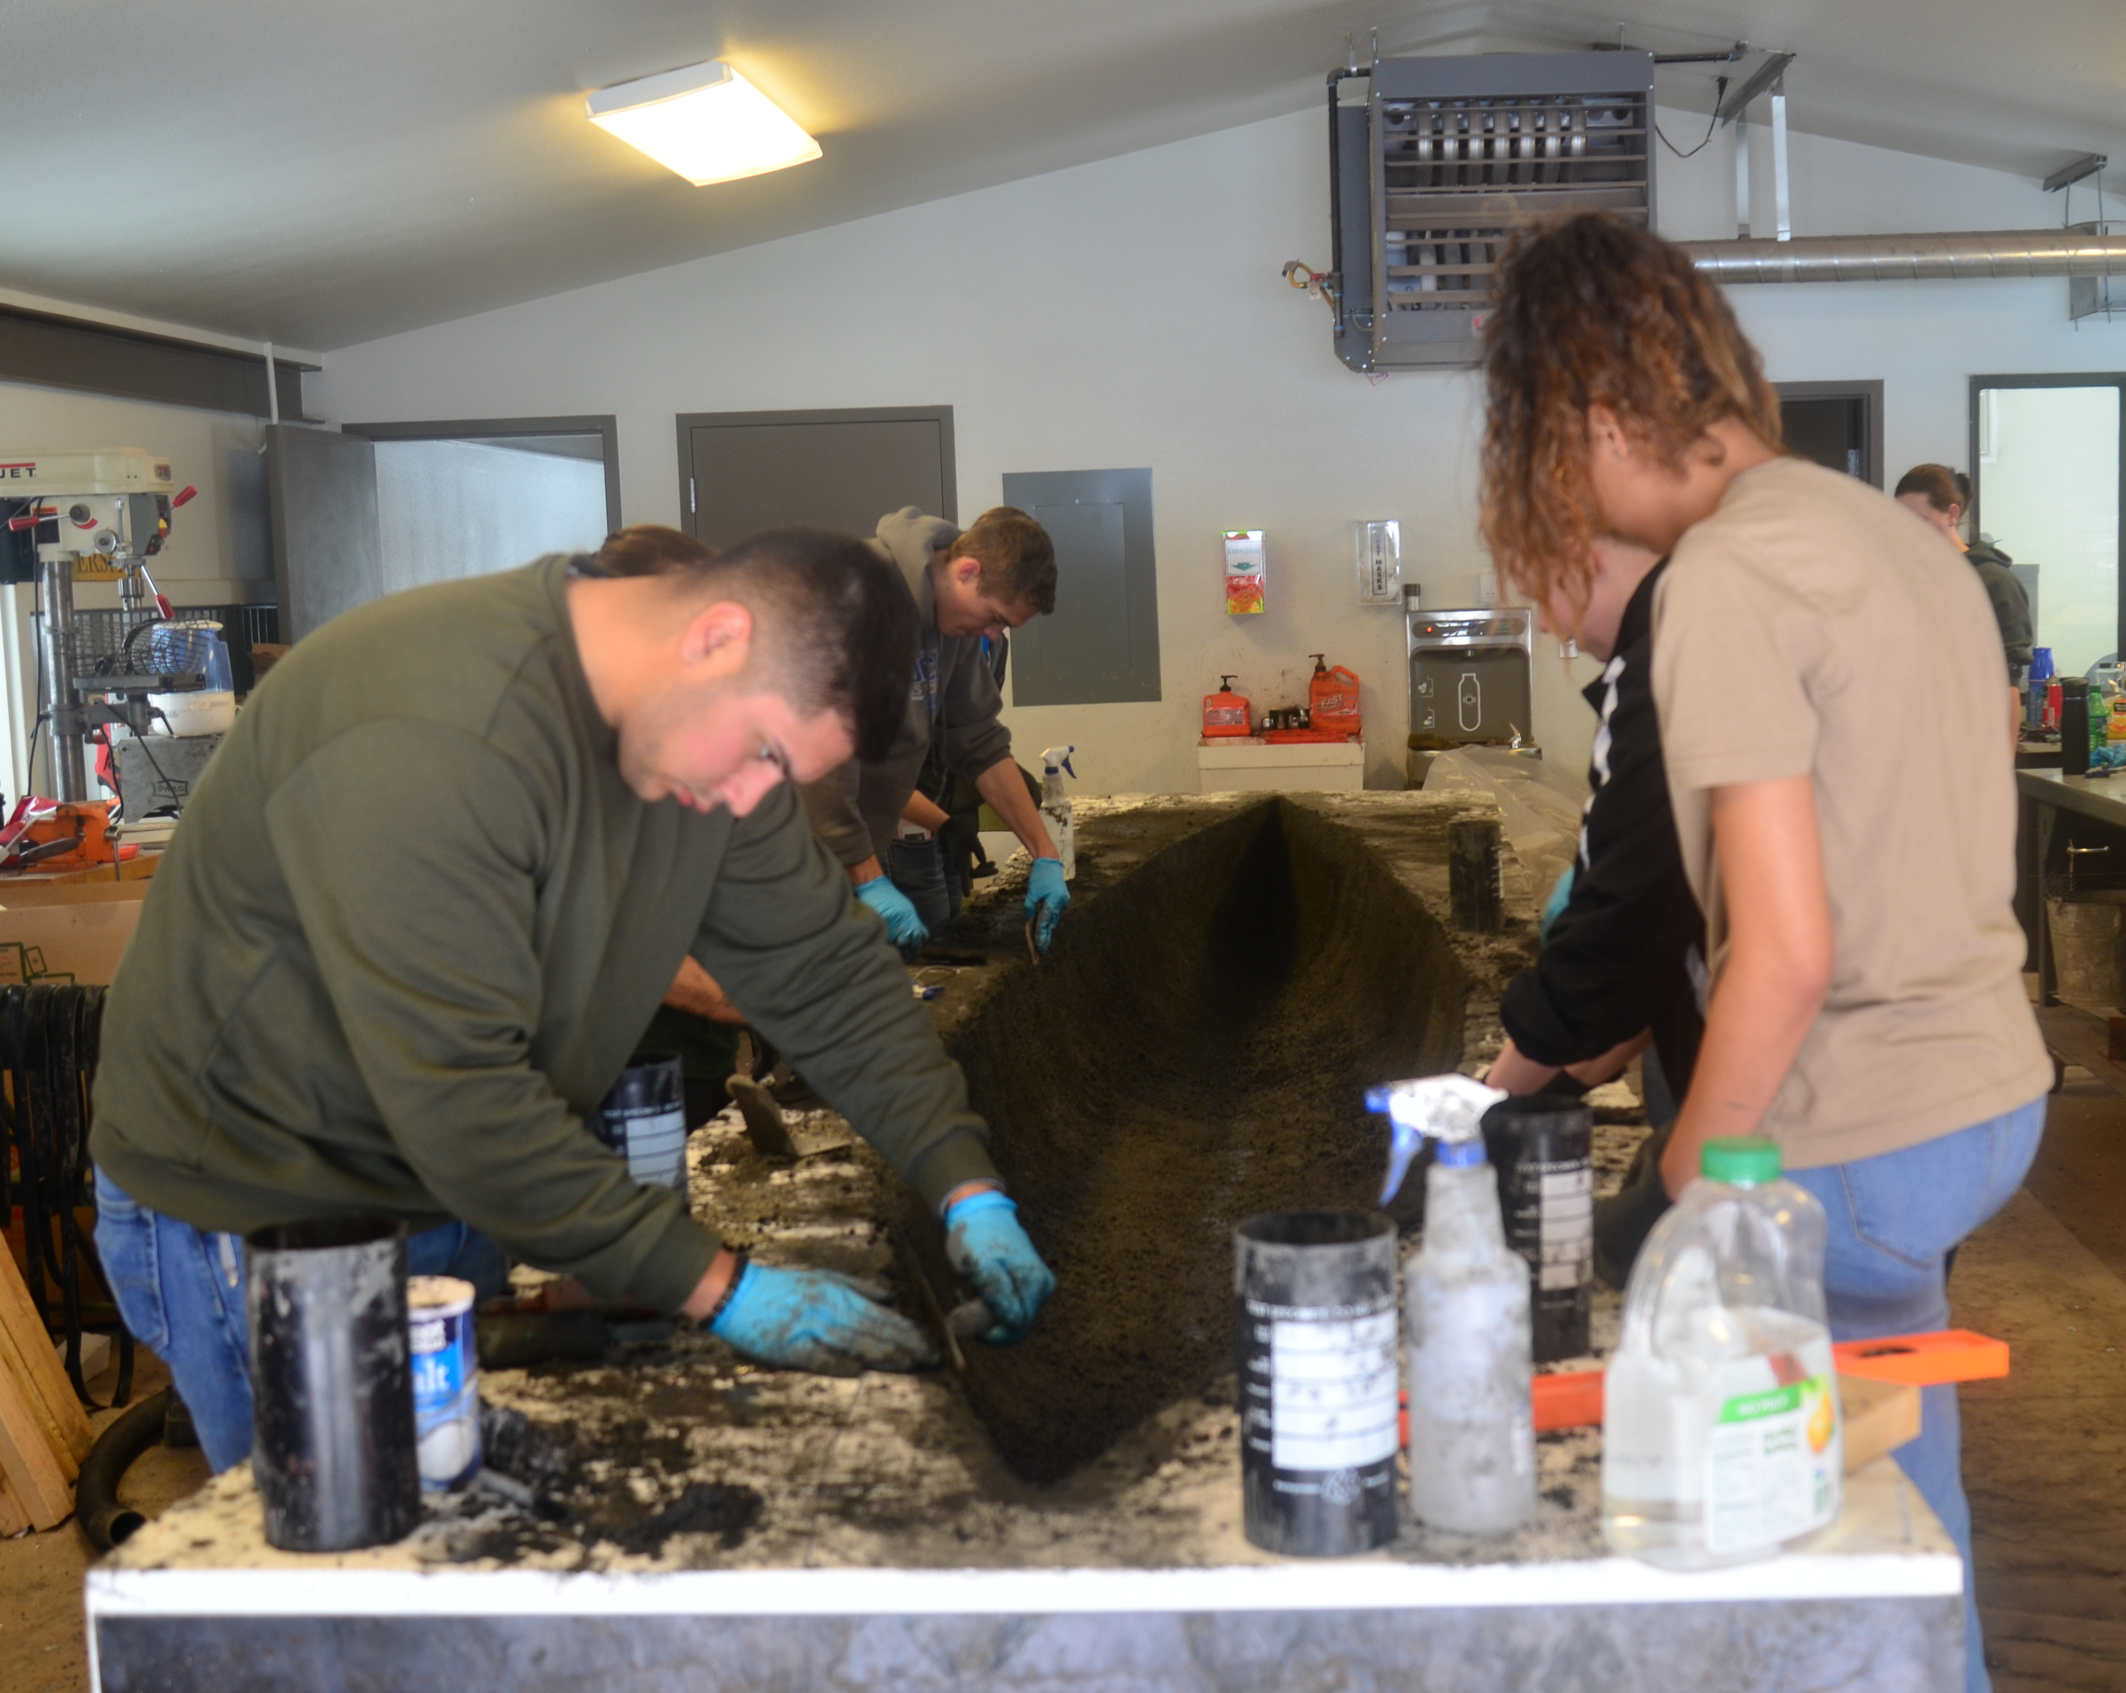
1.0 Project Understanding Cont'd
1.3 Technical Considerations
  Hull Design
  Concrete Mixture
  Structural Capacities
  Canoe Construction
  Aesthetics
1.4 Potential Challenges
  NCCC Rule Changes
  Mix Design
  Post Tensioning
  Mix Placement
Figure 3: Volcanoe Final Pour Day
Photo Credit: Carl Wilson

Slide 5

1.0 Project Understanding Cont'd
1.5 Stakeholders
  Northern Arizona University
  Northern Arizona University's College of
  Engineering, Informatics, and Applied Sciences
  (CEIAS)
  NAU ASCE Student Chapter
  Client – Mark Lamer (Engineering Professor)
  Team Sponsors
Figure 4: NAU Logo[3]

Slide 6
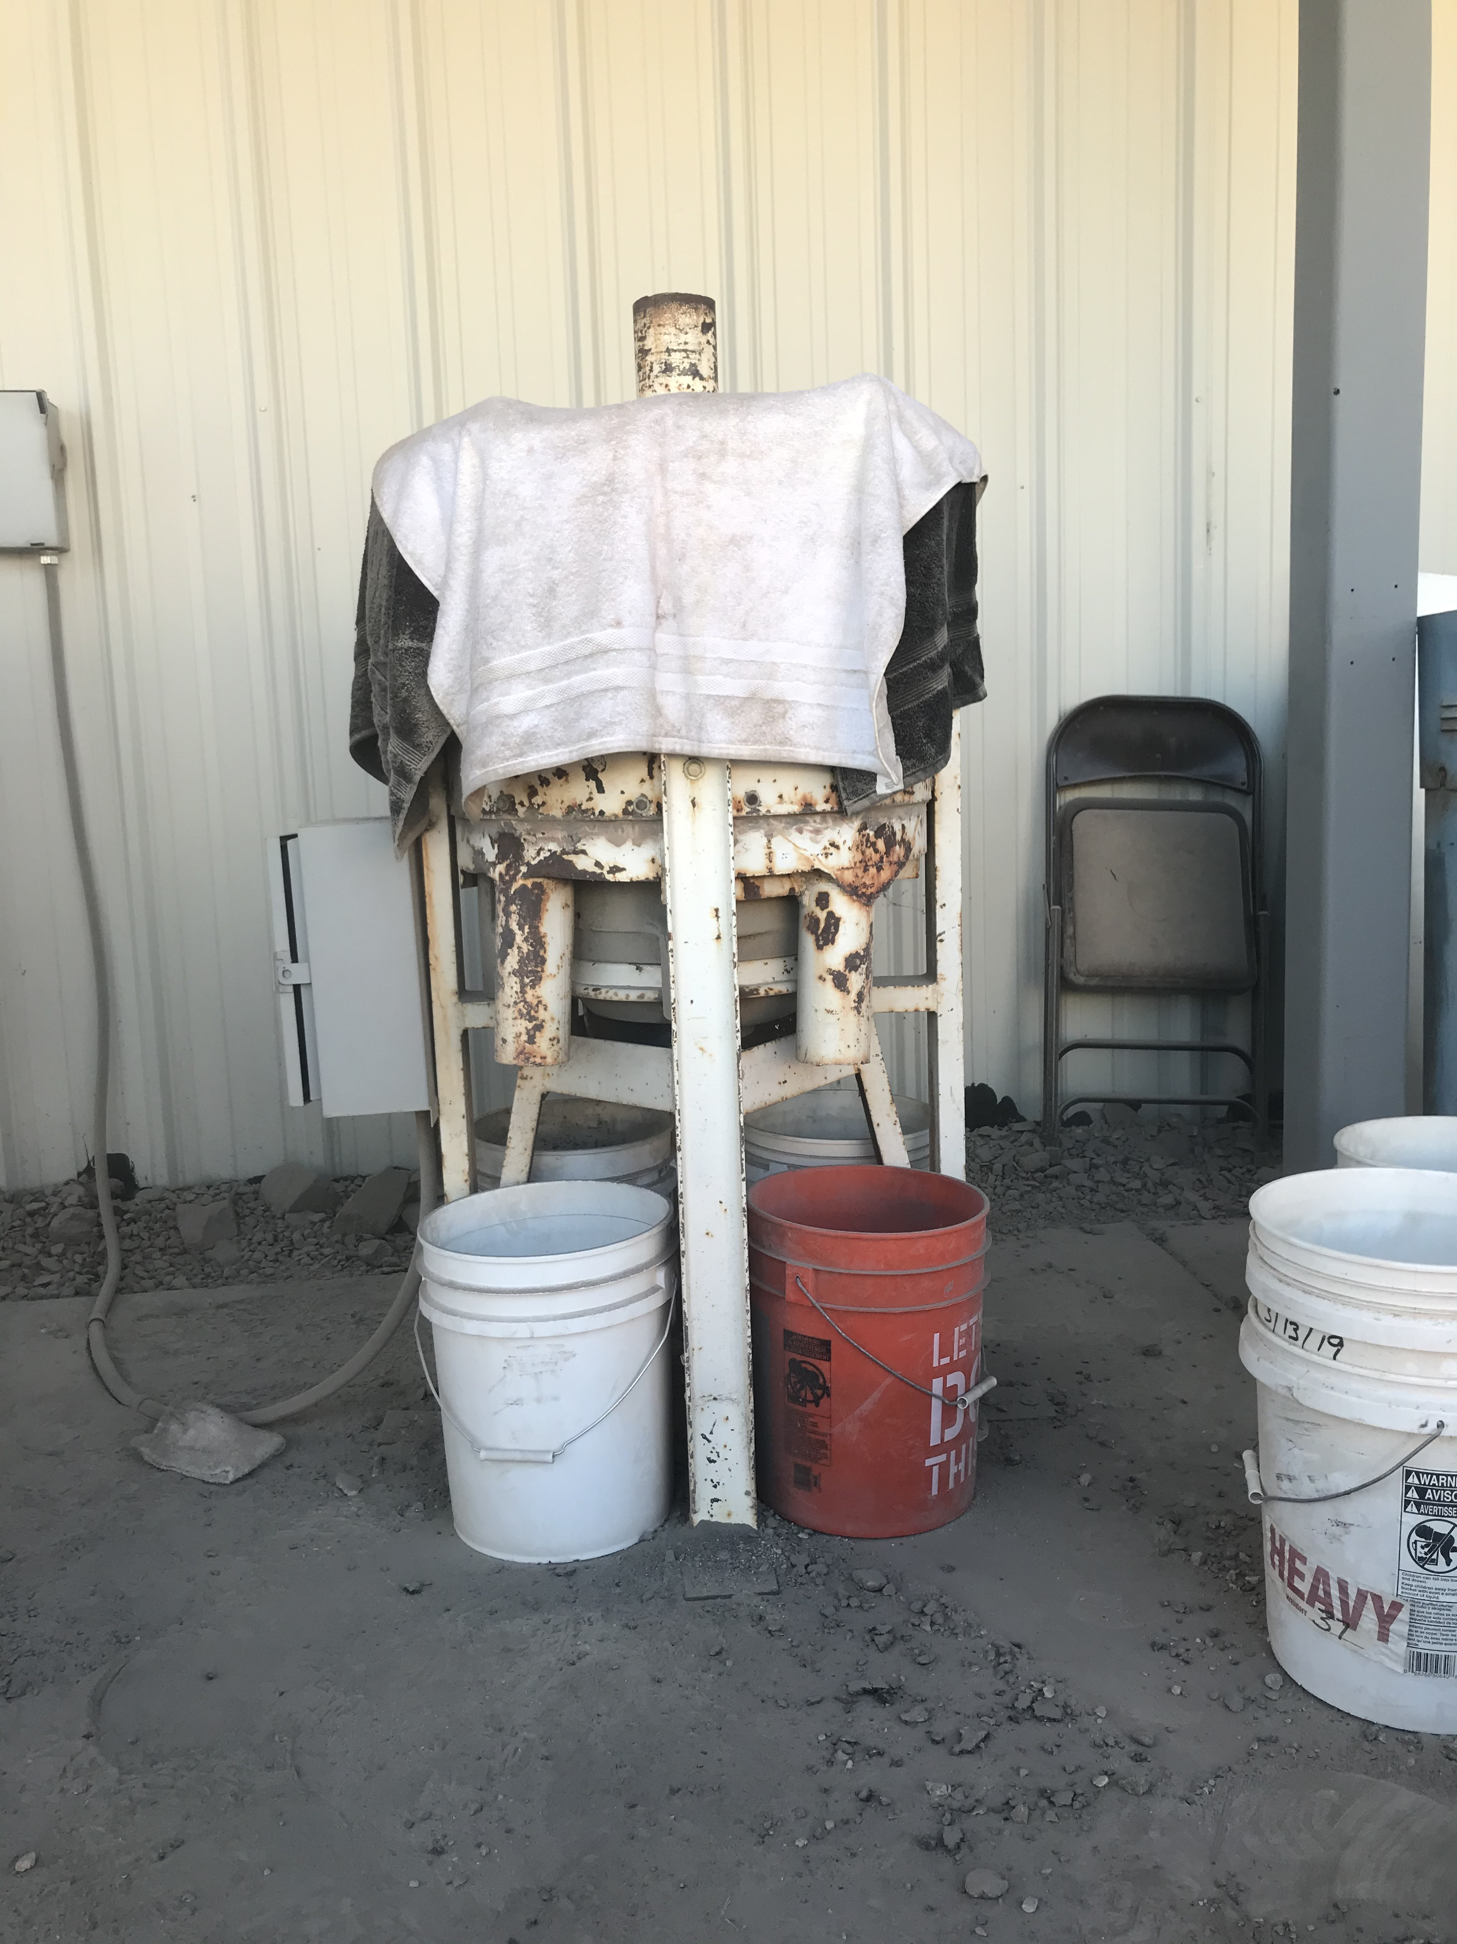
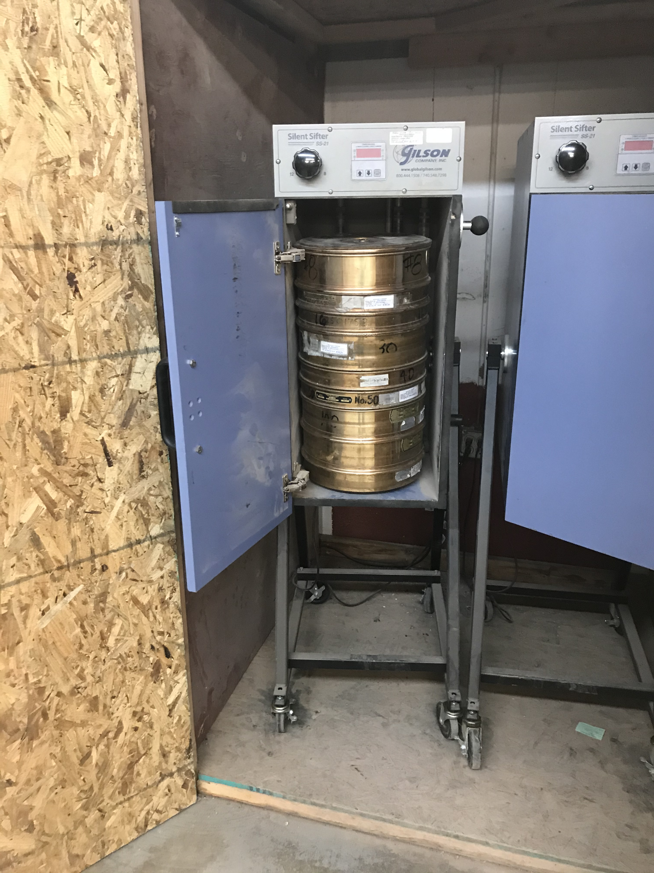
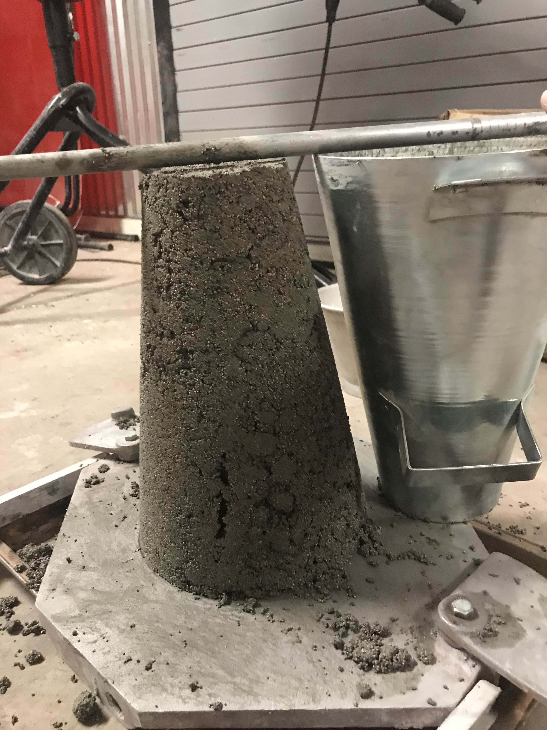
2.0 Scope of Services
Task 1: Mix Design
  Task 1.1 Material Research
  Task 1.2 Material Acquisition
  Task 1.3 Initial Mix Design
  Task 1.4 Initial Mix Testing
  Task 1.5 Alternative Mix Design Testing
  Task 1.6 Final Mix
Figure 5: Barrell Crusher
Photo Credit: Conrad Senior
Figure 6: Sieve Gradation
Photo Credit: Conrad Senior
Figure 7: Slump Test
Photo Credit: Conrad Senior

Slide 7
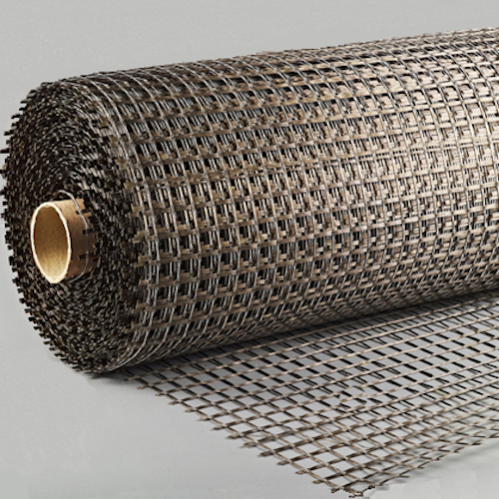
2.0 Scope of Services Cont'd
Task 2: Hull Design
Task 3: Structural Design
  Task 3.1 Calculation
    Ex. Buoyancy, Moment,
      Shear, Cracked Analysis
  Task 3.2 Mesh Selection
  Task 3.3 Material Testing
  Task 3.4 Post - Tensioning Placement
Figure 8: Basalt Mesh [5]

Slide 8
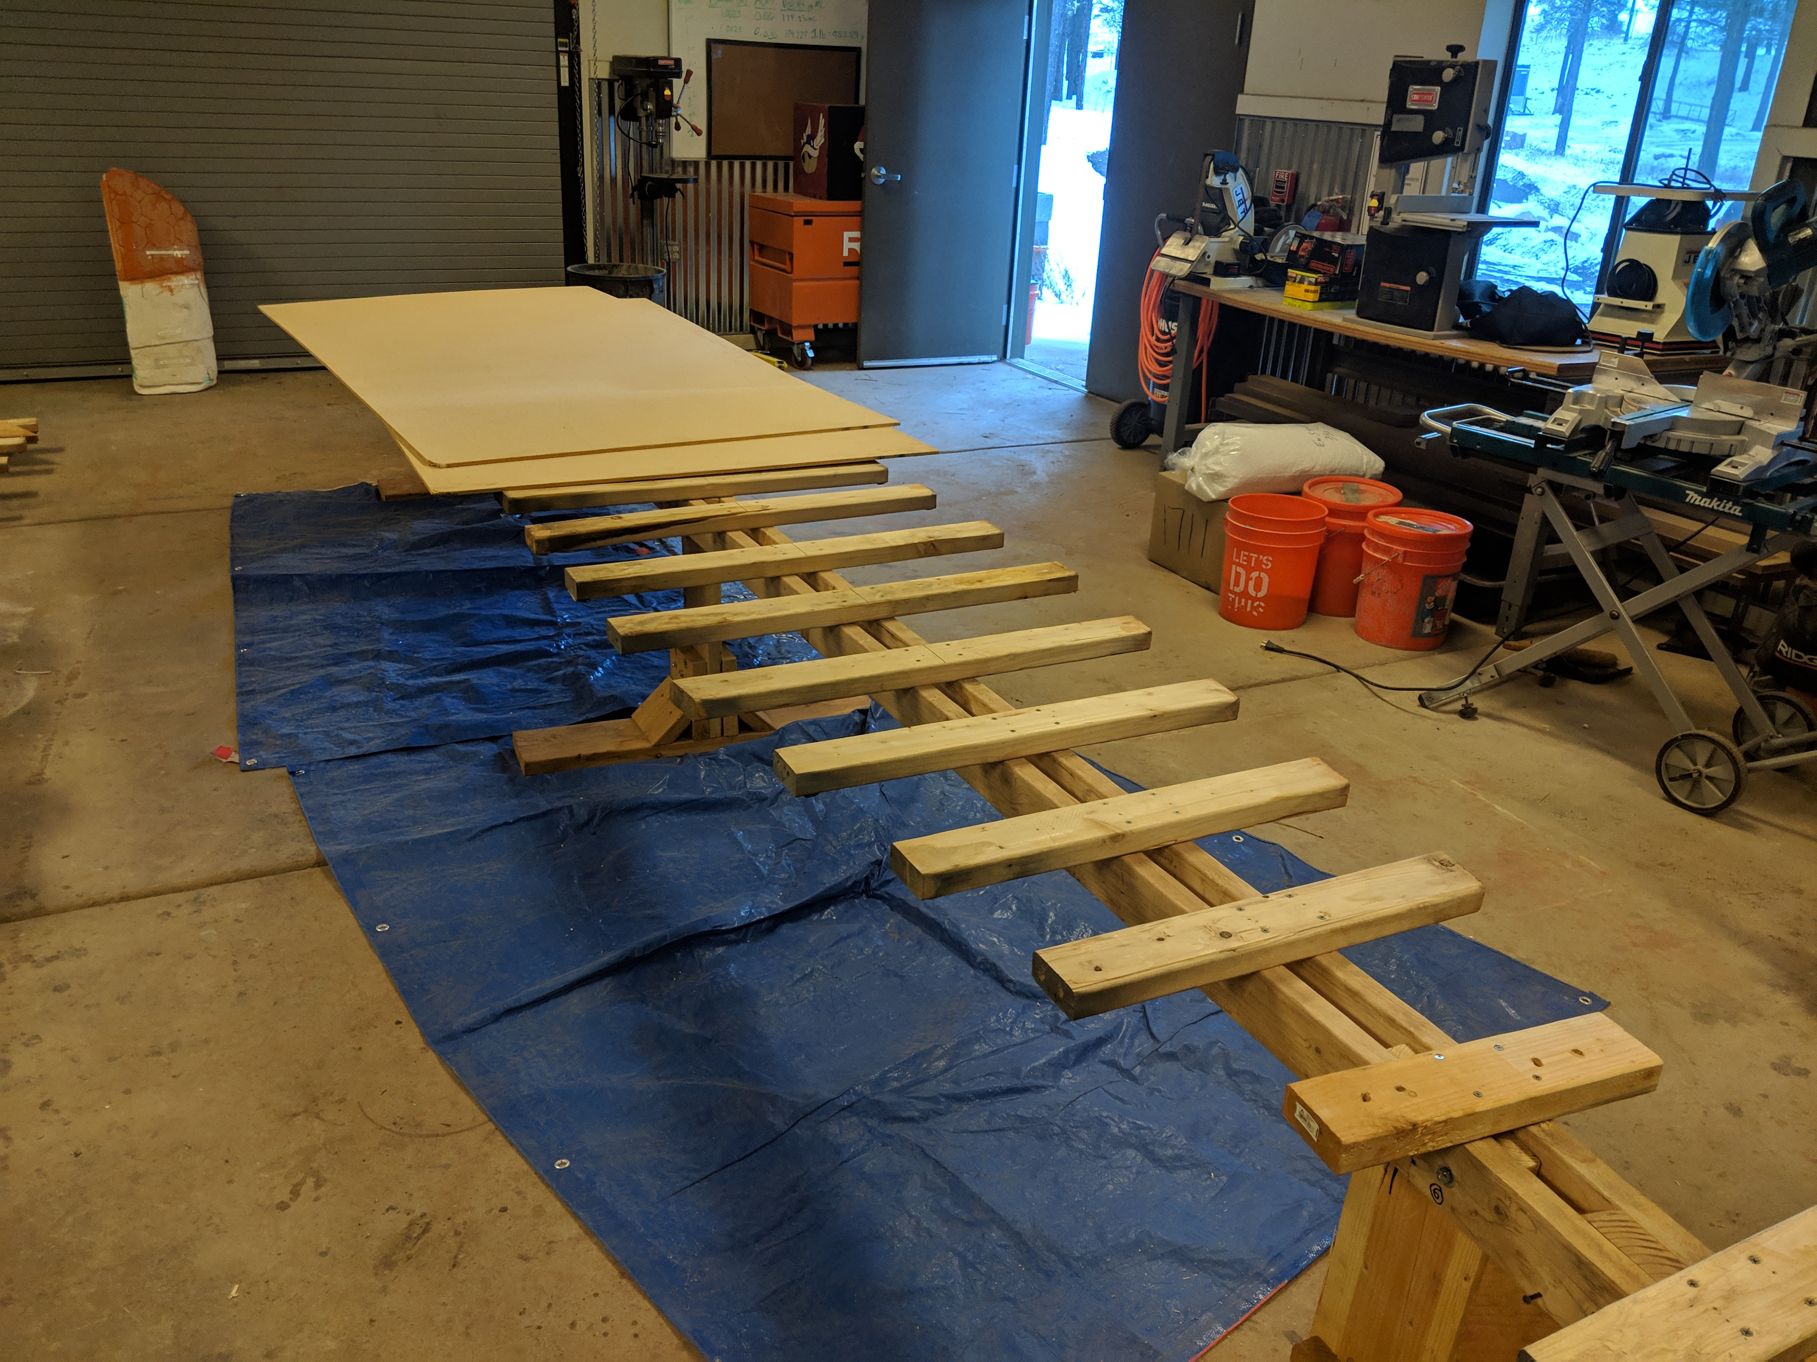
2.0 Scope of Services Cont'd
Task 4: Construction
  Task 4.1 Set Up
  Task 4.2 Practice Pour
  Task 4.3 Final Pour
Figure 9: Male Mold Pour Table
Photo Credit: Conrad Senior

Slide 9
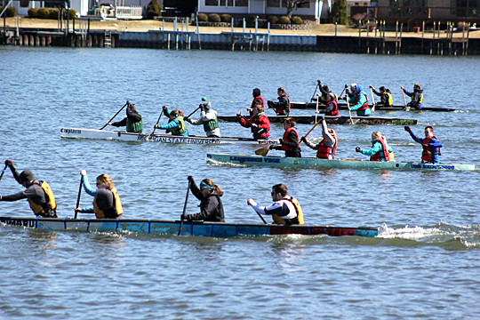
2.0 Scope of Services Cont'd
Task 5: Conference
  Task 5.1 Presentation
  Task 5.2 Report
  Task 5.3 Races
  Task 5.4 Display
Task 6: Capstone Deliverables
  Task 6.1 30% Report and Presentation
  Task 6.2 60% Report and Presentation
  Task 6.3 90% Report and Presentation
  Task 6.4 Final Report, Presentation, Website
Figure 10: 2017 PSWC Concrete Canoe Race
Photo Credit: Conrad Senior

Slide 10
2.0 Scope of Services Cont'd
Task 7: Project Impacts
  Task 7.1 Social
  Task 7.2 Environmental
  Task 7.3 Economics
Task 8: Project Management
  Task 8.1 Scheduling
  Task 8.2 Meetings (GI/TA/Team)
  Task 8.3 Fundraising

Slide 11
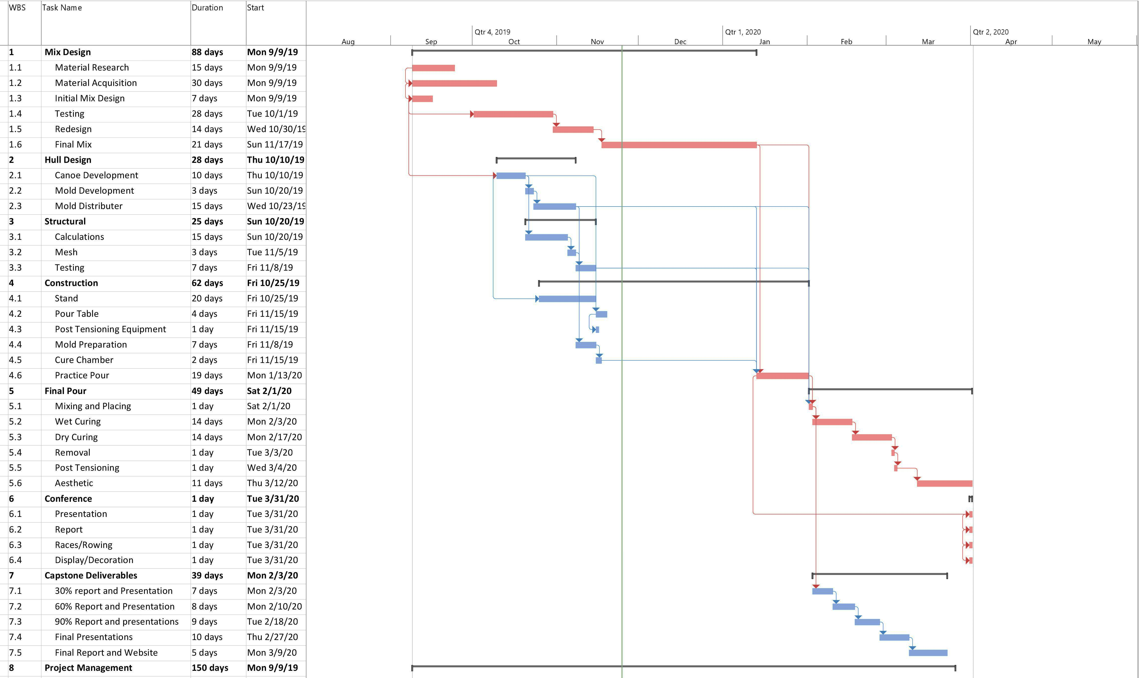
Critical Path: 204 Days

Slide 12
4.0 Staffing Personnel
Table 1: Staff Personnel Summary
Staff Summary
Title | Abbreviation
Project Manager | PM
Structural Engineer | SE
Design Engineer | DE
Materials Engineer | ME
Project Engineer | PE
Engineer in Training | EIT
Sub-Contractor | SUB
Lab Technician | LAB

Slide 13
4.0 Staffing Plan Cont’d
 | SE | DE | ME | PM | LAB | PE | EIT | SUB | Task Total (Hours)
Task 1: Mix Design | 0 | 13 | 78 | 19 | 49 | 45 | 39 | 0 | 243
Task 2: Hull Design | 10 | 30 | 0 | 2 | 0 | 10 | 0 | 0 | 52
Task 3: Structural Design | 55 | 15 | 5 | 2 | 10 | 35 | 10 | 2 | 134
Task 4: Construction | 21 | 65 | 48 | 18 | 0 | 44 | 5 | 92 | 293
Task 5: Conference | 15 | 15 | 5 | 25 | 0 | 25 | 25 | 40 | 150
Task 6: Capstone Deliverables | 16 | 16 | 16 | 8 | 0 | 16 | 8 | 0 | 80
Task 8: Project Management | 8 | 8 | 8 | 38 | 2 | 18 | 0 | 5 | 87
TOTAL HOURS | 125 | 162 | 160 | 112 | 61 | 193 | 87 | 139 | 1039

Slide 14
5.0 Cost of Engineering Services
Table 2: Cost of Engineering Services
Table 3: Cost of Engineering Services Cont'd
Engineering Services Cost Estimate
 | Classification | Quantity | UM | Rate ($/UM) | Cost
1.0 Personnel
 | PM | 112 | HR | 175 | $ 19,600
 | SE | 125 | HR | 150 | $ 18,750
 | DE | 162 | HR | 150 | $ 24,300
 | ME | 160 | HR | 150 | $ 24,000
 | PE | 193 | HR | 150 | $ 28,950
 | EIT | 87 | HR | 110 | $ 9,570
 | SUB | 139 | HR | 85 | $ 11,815
 | TECH | 61 | HR | 75 | $ 4,575
Sub-Total |  |  |  |  | $ 141,560
2.0 Travel
 | Conference Travel | 453 | MI | 0.58 | $ 263
 | Conference Registration | 5 | EA | 125 | $ 625
 | Conference Lodging (2 Rooms) | 3 | Nights | 450 | $ 1,350
Sub-Total |  |  |  |  | $ 2,238
Engineering Services Cost Estimate Cont.
 | Classification | Quantity | UM | Rate ($/UM) | Cost
3.0 Lab Facilities
 | Concrete Laboratory | 20 | HR | 30 | $ 600
 | Field Station | 30 | HR | 25 | $ 750
Sub-Total |  |  |  |  | $ 1,350
4.0 Supplies
 | Cementitious Material | 10 | CF | 5 | $ 50
 | Aggregates | 12 | CF | 6 | $ 72
 | Admixtures | 3 | GAL | 10 | $ 30
 | Basalt Mesh | 13 | SY | 10 | $ 130
 | 1/8" Inch Cable | 108 | LF | 0.32 | $ 35
 | Cable Sleeve | 108 | LF | 0.11 | $ 12
 | Transportation Device | 1 | LS | 75 | $ 75
 | Display | 1 | LS | 125 | $ 125
Sub-Total |  |  |  |  | $ 528
5.0 Sub-Contract
 | Mold | 2 | EA | 900 | $ 1,800
Sub-Total |  |  |  |  | $ 1,800
6.0 Total |  |  |  |  | $ 147,476

Slide 15
References
[1]NCCC, Asce.org, 2019. [Online]. Available: https://www.asce.org/uploadedFiles/Conferences_and_Events/Event_Subpages/Content_Pieces/2020_nccc_request_for_proposals-rules.pdf. [Accessed: 26- Nov- 2019].
[2]"Boating Information", FRANK G. BONELLI REGIONAL PARK, 2019. [Online]. Available: https://www.bonellipark.org/boating.html. [Accessed: 26- Nov- 2019].
[3]Visual Identity Guide. (2019). University Marks | Visual Identity Guide. [online] Available at: https://nau.edu/visual-identity-guide/university-marks/ [Accessed 3 Dec. 2019].
[4]Systems, S., Policy, P., Store, B., Blog, B., BLOG, B., FAQs, B., Codes, B., Store, B., PDF, B., Form, B., 8422, P. and NICK, E. (2019). Basalt Reinforcement Mesh Geo-Grid is better than steel. [online] Basalt Mesh. Available at: https://basalt-mesh.com/ [Accessed 3 Dec. 2019].
[5]Canoeing.com. (2019). Canoe Design · Canoeing.com. [online] Available at: http://canoeing.com/canoes/canoe-design/ [Accessed 3 Dec. 2019].

Slide 16
Thank You!

